Slide 1
Auto Encoders
Alex Litzenberger

Slide 2
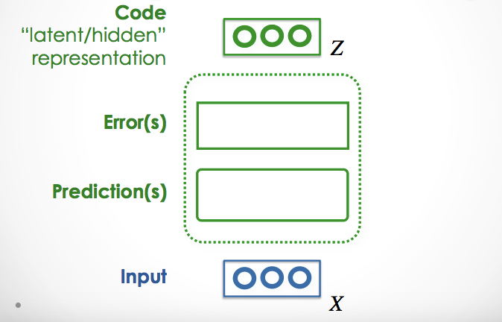
What they are.
A method for unsupervised learning
Creates and encoding of the input with higher level representations

Slide 3
Deep autoencoders
Utilise deep neural networks to autoencode

Slide 4
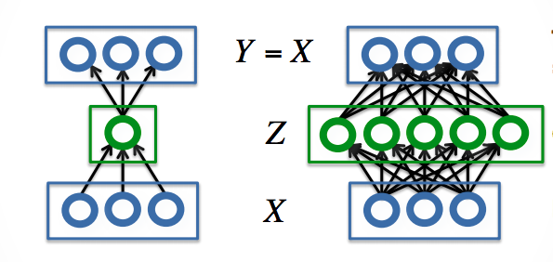
Sparsity and Density
Since the goal is to get an encoding of the input of the information that is informative it is desirable for the encoder to learn features of the input data. If sparsity or density were not enforced on the machine it would simply learn the identity function so auto encoders tend to either be sparse or dense.

Slide 5
Sparsity
Entails the cost function taking account of the total value of the output weights.

Slide 6
Density
Entails having few parameters in the encoding.

Slide 7
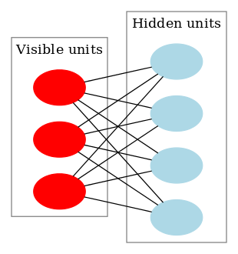
Restricted boltzmann machines (RBMs)
Two layer neural networks
Generative
Learn features of the visible layer
Have sparse or dense representations
Cost function is a function of reconstruction accuracy.
Input is the goal output

Slide 8
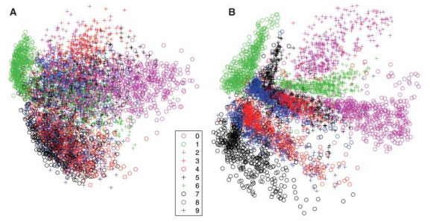
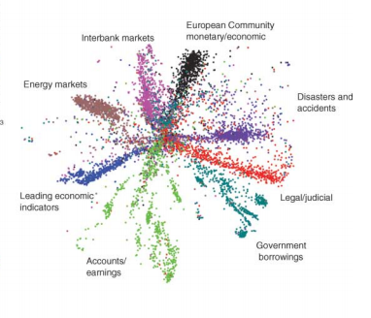
A bit of History
The creation of DNN autoencoders is usually credited to Hinton & Salakhutdinov and their 2006 paper Reducing the Dimensionality of Data with Neural Networks

Slide 9
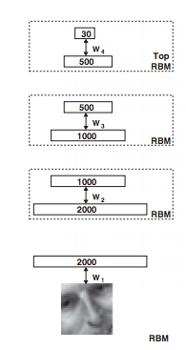
Stacked RBMs
The paper showed that RBMs could be effectively stacked
The outputs to a given RBM were used to train the next RBM
This allows feature encoding multiple times over.
The layers usually get progressively more sparse or dense.

Slide 10
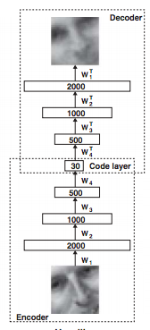
Unrolling
Once the RBMs are trained the encoder can be “unrolled”
The encoder simply allows the output from one level to be used as input for the next directly rather than for training.
The decoder inverts the activation function
Feeds forward through the layers in reverse order
Initialised with the same weights as the encoder

Slide 11
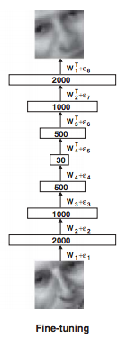
Training an autoencoder
Referred to as fine tuning
The unrolled autoencoder is trained on reproducing input.
Uses standard backpropagation and stochastic gradient descent.
Takes account i the multi-layer interactions to produce better reproductions and representations.

Slide 12
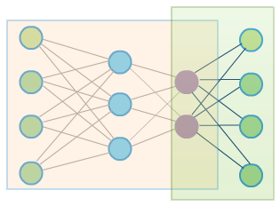
Symmetric vs. Asymmetric
So far only symmetric auto-encoders have been covered.
There are also Asymmetric auto-encoders.
Rather than unrolling the network a distinct decoder is used.
This decoder could be a neural network with different initialisation parameters
It could also be an of an entirely different form.
Autoencoders are not limited to deep neural nets!

Slide 13
Advantages of Autoencoders
Produce higher level feature encodings.
Can be trained for specific desirable encodings.
Search, and encoding are fast after learning is done.
Can leverage large amounts of unlabeled data.
Allow more transparency than most neural networks into their inner workings.
Encodings can produce independant incite into the underlying structure of the data.

Slide 14
Use cases

Slide 15
Semantic Hashing
Determining the subject of a document.
Determining the relation two documents have.
Creates many dimensional feature vectors for each document
Allows document similarity to be assessed by computing the cosine of the arch between the feature vectors.
A set of documents similar to a document can be produced in constant time (in regard to the number of documents) simply by determining the feature vector of the document.

Slide 16
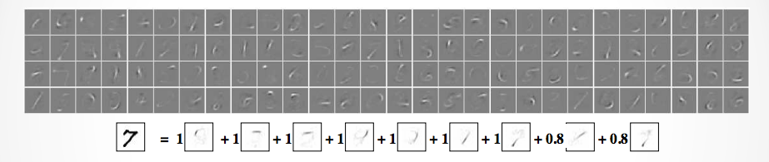
Image autoencoding
MNIST dataset
Learned feature representations
High quality “natural” reproduction

Slide 17
Important Papers

Slide 18
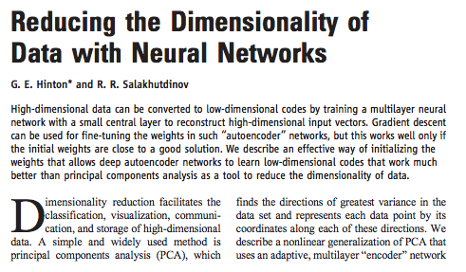
Reducing the Dimensionality of Data with Neural Networks

Slide 19
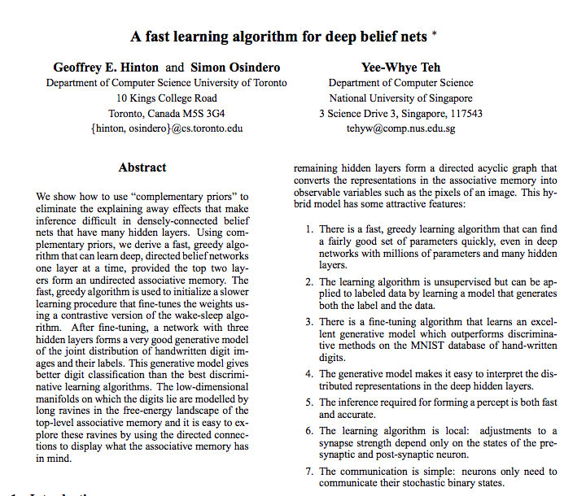
A fast learning algorithm for deep belief nets

Slide 20
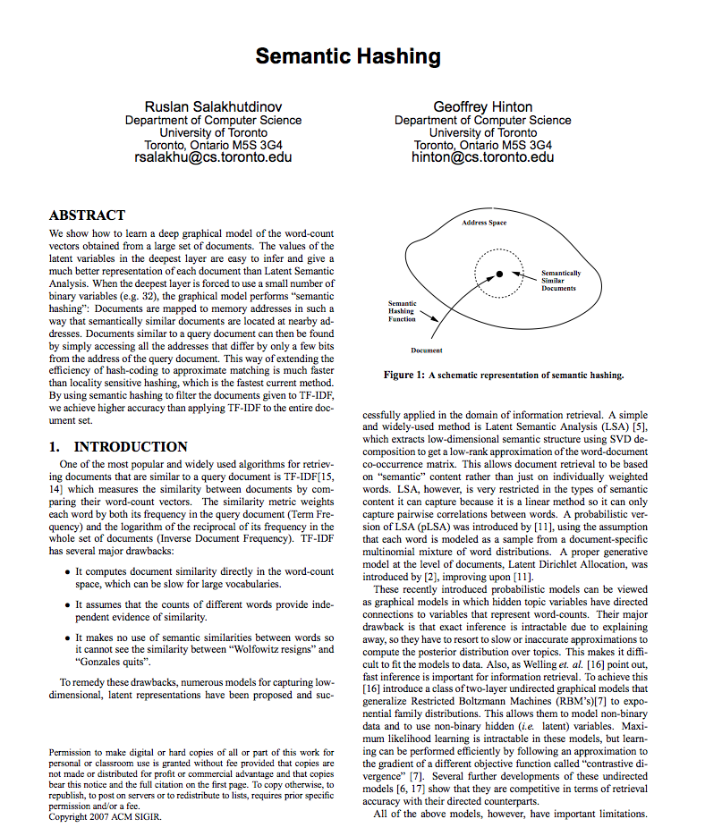
Semantic hashing

Slide 21
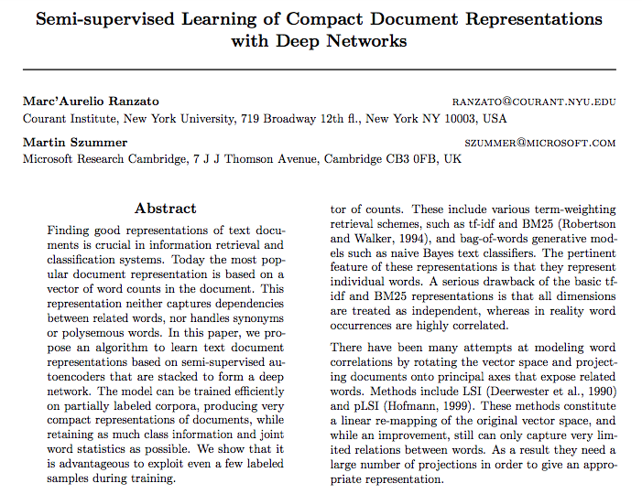
Semi-supervised Learning of Compact Document Representations with deep Networks

Slide 22
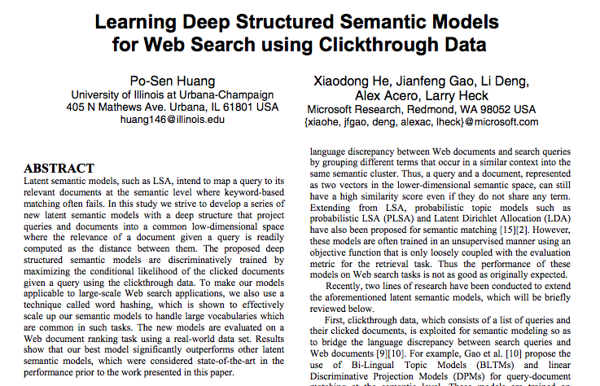
Learning Deep Structured Semantic Models for Web Search using Clickthrough Data

Slide 23
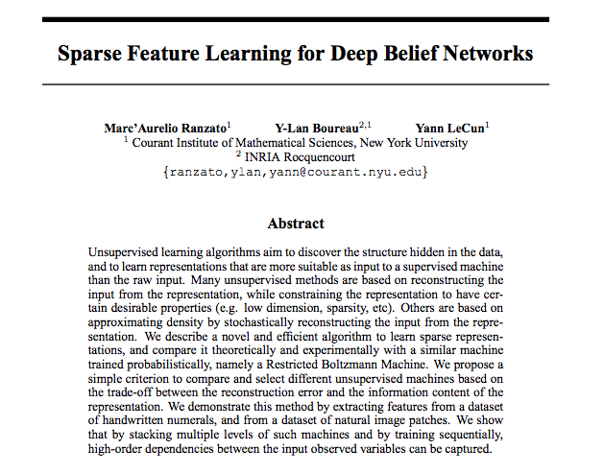
Sparse Feature Learning for Deep Belief Networks

Slide 24
Sources
Totorial on auto encoders: https://piotrmirowski.wordpress.com/2014/03/27/tutorial-on-auto-encoders/
All the papers in the previous slides
Deeplearning4j.org
http://www.jmlr.org/papers/volume11/vincent10a/vincent10a.pdf
int8.io

